Slide 1

Remote work and Employee mental Health

Slide 2

AGENDA
INTRODUCTION
Reading & preparing Data
Demographics
Questions
Visualizations and Analysis

Slide 3

Introduction to the Data

Slide 4

Dataset Characteristics
“Remote Work & Mental Health (Kaggle.com) – Waqar Ali (author)
Data was collected via a structured survey
Qualitative and quantitative values
Distributed digitally across social media platforms, professional networks, and online forums; responses were anonymized
CSV file stored in GitHub repository
5000 rows x 20 columns

Slide 5
Limitations of the Dataset
Job roles
Years of experience
Work location
Number of virtual meetings
Mental health conditions
Access to mental health supports
Physical activity
Qualitative vs. quantitative values

Slide 6
Methods
Placed CSV file in GitHub repository
Read file
Printed basic info about dataframe
Removed Employee_ID column
Assigned integer values to discrete string values
Filled in “NaN” values as appropriate
Sorted and grouped data for visualizations and analyses
Plotted data to explore trends and patterns

Slide 7
(1) Demographic Trends (2) Relationship between work location and work life balance? (3) Relationship between region and stress level by work location? (4) Relationship between work location and work life grouped by whether the employee had access to MH supports? (5) Relationship between physical activity and work location by Region? (6) Relationship between work location and social isolation ratings by mental health condition? (7) Relationship between work location and mh Condition?
QUESTIONS Posed

Slide 8
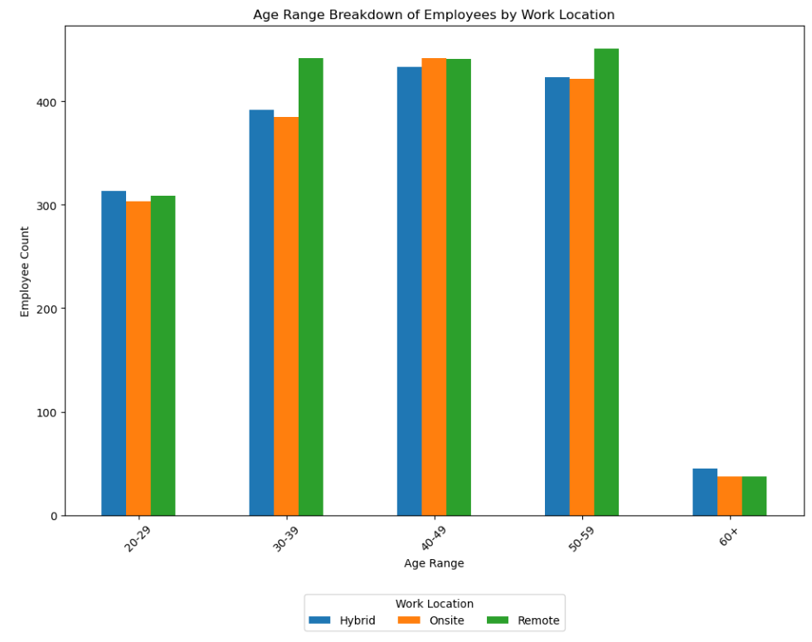
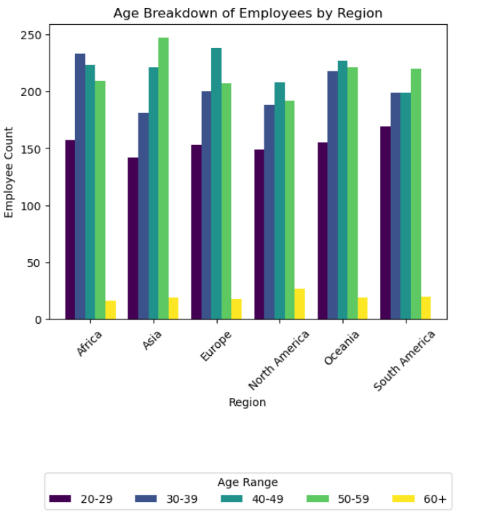
Demographics Trends

Slide 9
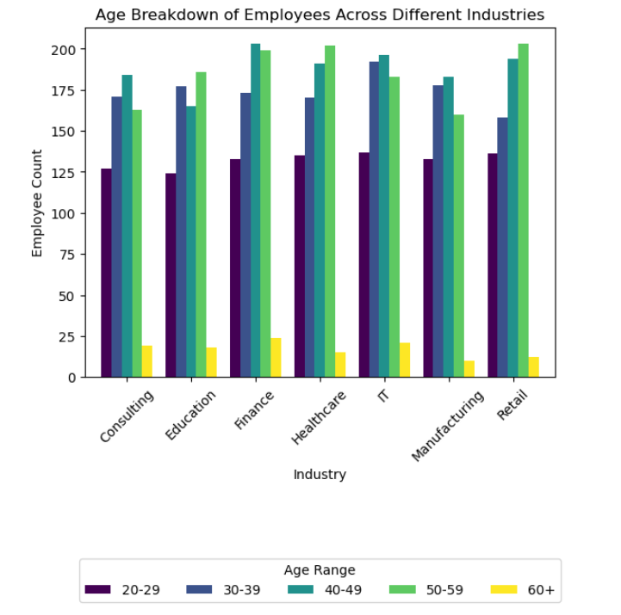
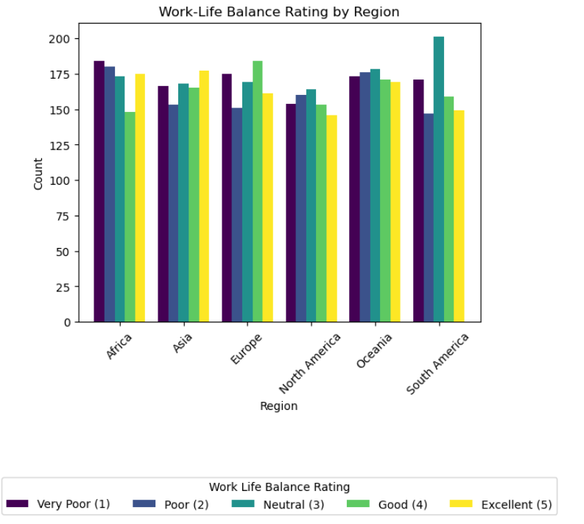
Demographic Trends

Slide 10
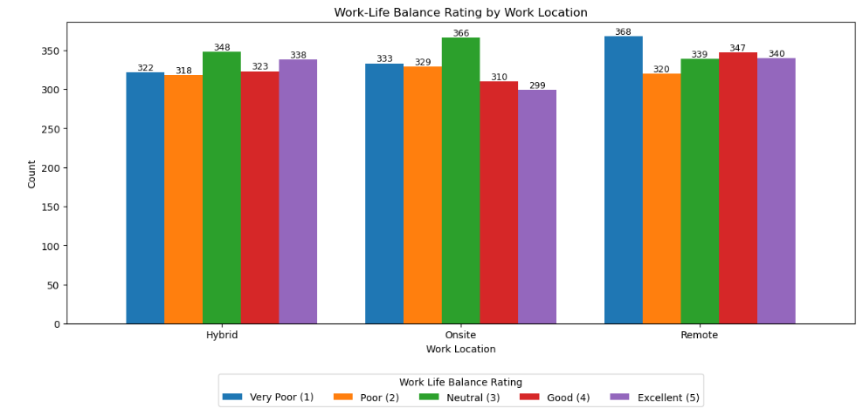
Relationship between work location and work life balance

Slide 11
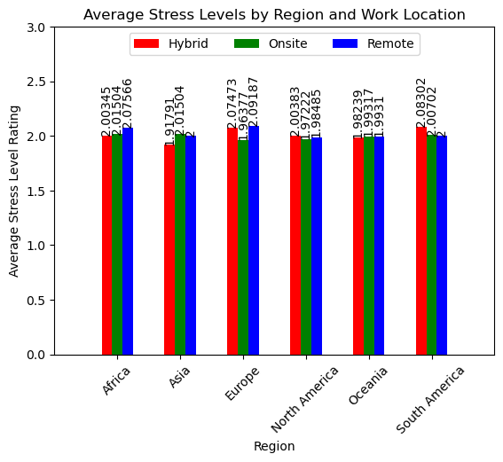
Relationship between region and stress level by work location

Slide 12
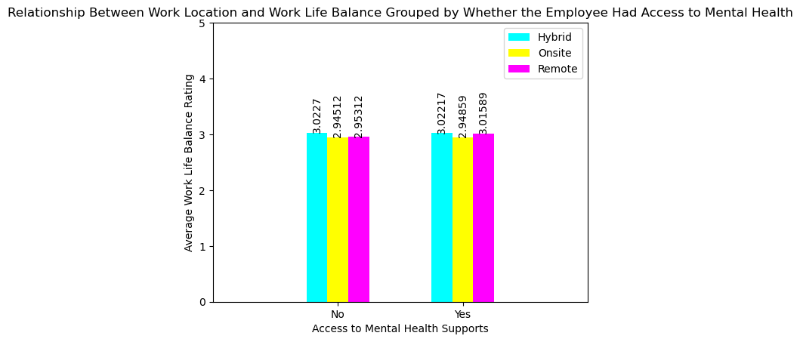
Relationship between work location and work life grouped by whether the employee had access to MH supports

Slide 13
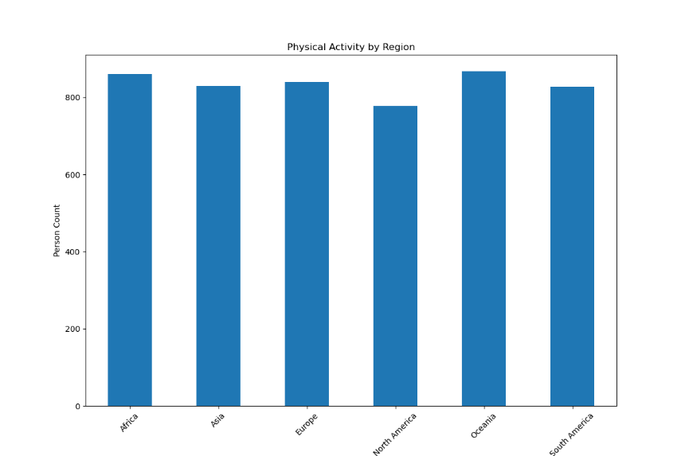
Relationship between physical activity and work location by Region

Slide 14
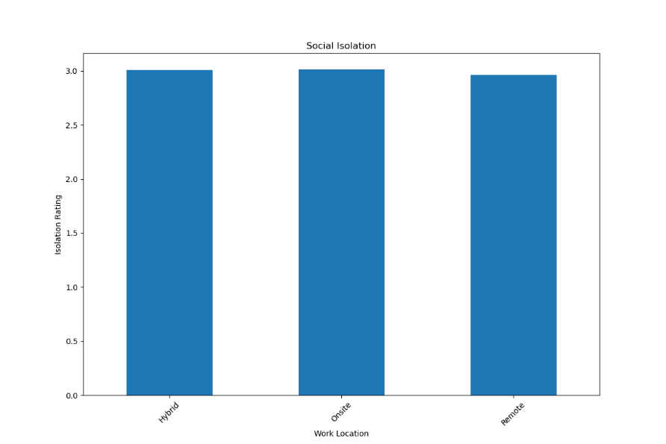
Relationship between work location and social isolation ratings by mental health condition

Slide 15
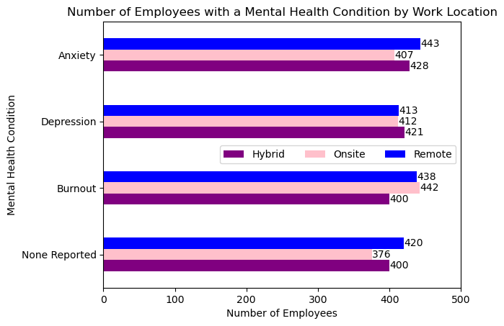
Relationship between work location and mh Condition

Slide 16

THANK YOU
Mélisa Teglas
meliteg@gmail.com
Tamya Louis
tamyalouis@gmail.com
Don Ross
ross.donross@gmail.com

